Slide 1

AgrIoT
By:
K.Kirishikesan
https://github.com/Kirishikesan/Smart-plant-monitoring-system
01/05/2020

Slide 2
Introduction
A network of sensor nodes which collect data such as humidity, temperature, moisture gradient, light intensity and electrical conductivity and an airborne drone which collects image data and integrates the system for data analysis.
Parts of the project:
Sensor nodes
Mesh network of nodes
Communication protocol between node and drone
Drone
Data analysis
01/05/2020

Slide 3
Phase 1
Done by:
Aruna Jayasena
Radershan Suguneswaran
Ketharan Suntharam
Thiru Ashok
Created a prototype for Sensor Node with a custom sensor for Electrical conductivity
Created an app with cloud storage for data collection from a single node
Created drone based image data collection
01/05/2020

Slide 4
Phase 2
Done by:
A.L.D.S. Liyanage
K.Kirishikesan
A communication protocol between sensor nodes and the drone
Mesh network of nodes
01/05/2020

Slide 5
Power Consumption of protocol in phase 2
HC12- sleep………………….80µA
HC12- transmission……..3.6mA
Stm32f103c8t6…………….8mA
Total current consumption per hour:29.6928A
6 months:5344.704
Needed battery:494mAh battery
01/05/2020

Slide 6
Phase 3
By:
K.Kirishikesan
Production ready sensor nodes
Dynamic mesh network functionality
Communication protocol to communicate with the drone
01/05/2020

Slide 7
Work breakdown
Mesh network creation
Communication protocol
Implementation of protocol
Implementation of Sensor node
Enclosure design
Enclosure printing
Electrical conductivity sensor design
RFC
PCB design
PCB printing
Assembly and finish
01/05/2020

Slide 8
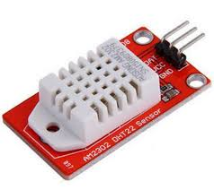
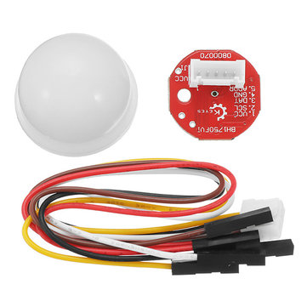
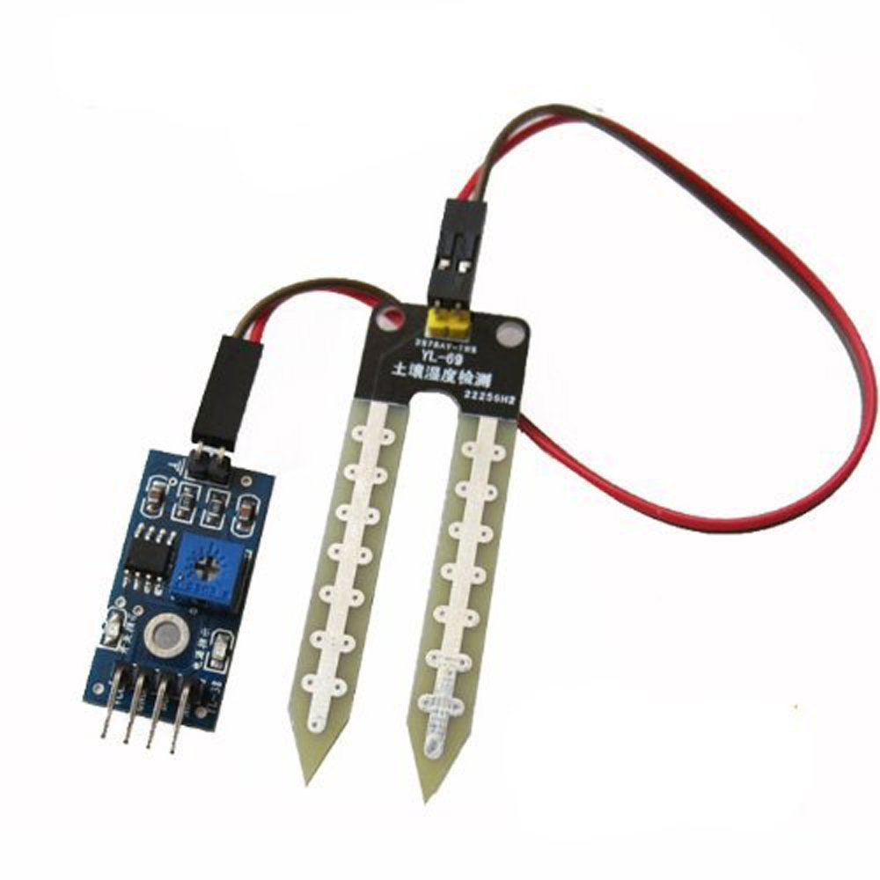
Sensor node
Sensor node is equipped with the following sensors
DHT22/AM2302 Temperature & Humidity sensor
BH1750 Light Intensity sensor
YL69 Soil moisture sensor
01/05/2020

Slide 9
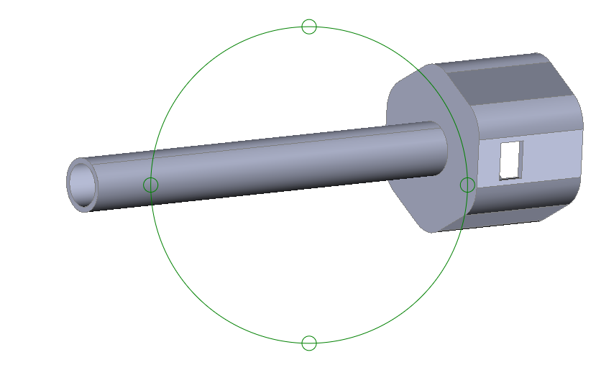
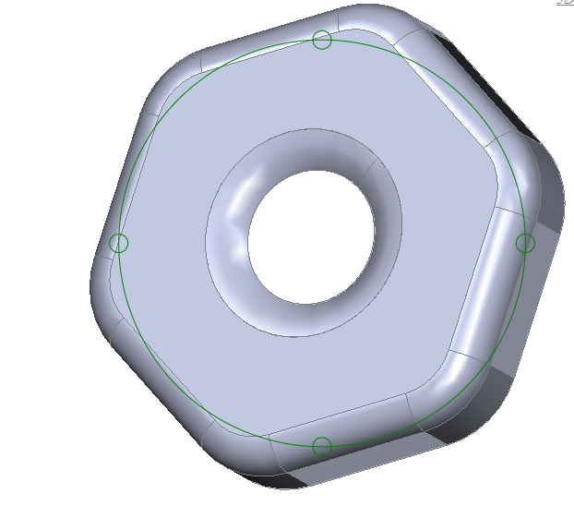
Enclosure
01/05/2020

Slide 10
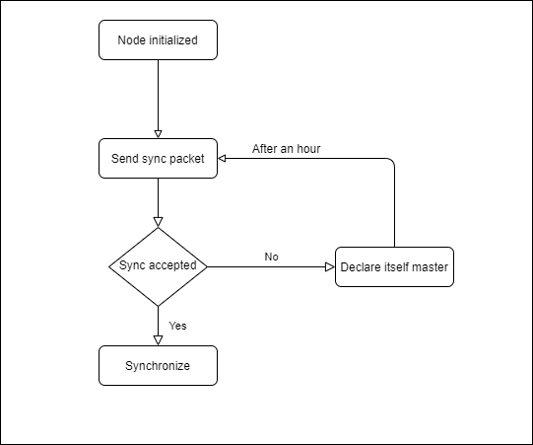
Mesh network creation
01/05/2020

Slide 11
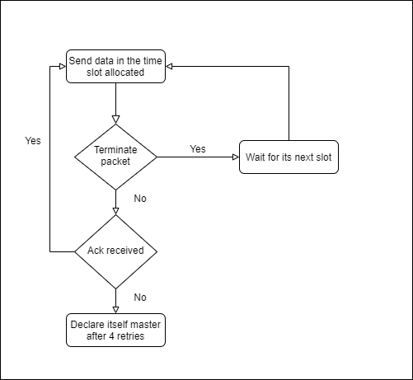
Send data as to master
01/05/2020

Slide 12
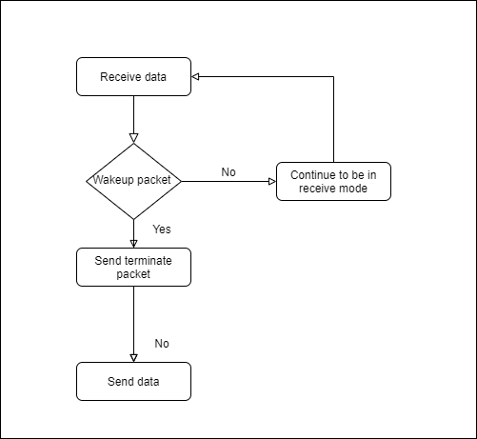
Receive data as master from other nodes
01/05/2020

Slide 13
Implementation issues and solutions
Multiple masters: Every master will keep a list of all the node ids that were synced with this master and will discard any message send from any other nodes and will not respond
Master role switch: As the master will be continuously keeping its radio on, the master role will be switched after every 4 hours. The slaves which are connected to the master will try to send data in their next round but will fail to receive acks and then declare themselves master. After an hour they will start synchronization again and eventually be part of the network
Hidden node problem: The node will declare itself a master
Too much traffic: Only the masters will transfer data to the drone
Power fluctuation if radio is on for more than 5 days: every 4 hours master role will be switched.
01/05/2020

Slide 14
Frame Structure when in sync state
1 bit to identify state
8 bit sender id
8 bit receiver id
Content:Timestamp
4bit Error bits(even parity in blocks)
01/05/2020

Slide 15
Frame Structure when in Data-transfer state
1 bit to identify state
3 bit code to identify type of frame
8 bit drone id
8 bit node id
Content: Data or initial or final sequence number of transmission
4bit Error bits(even parity in blocks)
01/05/2020

Slide 16
Frames and their identification codes
Wake-up frame(001)
Request frame(010)
Response frame(011)
Data frame(100)
Ack frame(101)
Retransmission frame(110)
Termination frame(111)
Switchrole frame(000)
01/05/2020

Slide 17
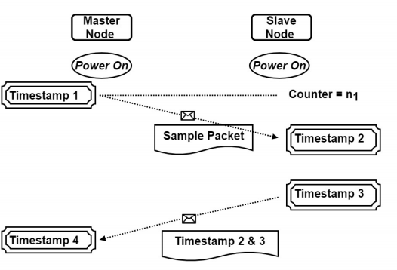
Message based Synchronization
Other
node
Master
node
Time of slave node will be reset to = t4+ ((t2-t1)+(t4-t3))/2
01/05/2020

Slide 18
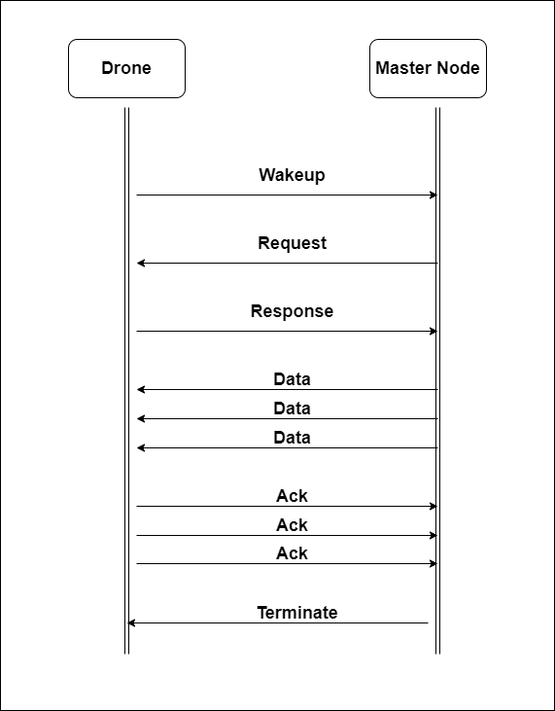
Communication protocol
01/05/2020

Slide 19
Progress
Mesh network creation …………………………. Complete
Communication protocol ………………………. Complete
Implementation of protocol…………………… Pending
Implementation of Sensor node…………….. Pending
Enclosure design……………………………………….Complete
Enclosure printing…………………………………….Pending
Electrical conductivity sensor design …….. Pending
RFC…………………………………………………………….Pending
PCB design……………………………………………....Pending
PCB printing………………………………………………Pending
Assembly and finish………………………………….Pending
01/05/2020

Slide 20
Next week progress
PCB design
Electrical conductivity sensor integration
01/05/2020

Slide 21
Week 9 continued…
Redesigned objectives:
Design Mesh network………………………………………………………………………Complete
Design Communication protocol between node and drone…………..Complete
Simulate Mesh network…………………………………………………………………..On Progress
Simulate Communication protocol………………………………………………….On Progress
Combine Simulations……………………………………………………………………….Incomplete
Include power consumption calculation with the simulation…………Incomplete
Prepare an RFC…………………………………………………………………………………Incomplete
08/05/2020

Slide 22
Redefined Deliverables
Working Simulations of mesh network and communication protocol
Complete RFC
08/05/2020

Slide 23
This week’s progress
Familiarized myself with Omnet++ Discrete Event Simulator Framework
Unique id solution for the mesh network design.(Using mac-id)
Completed two simple simulations.
Drone to master node communication (One drone and one master)
Drone to master communication (One drone and 4 masters)
08/05/2020

Slide 24
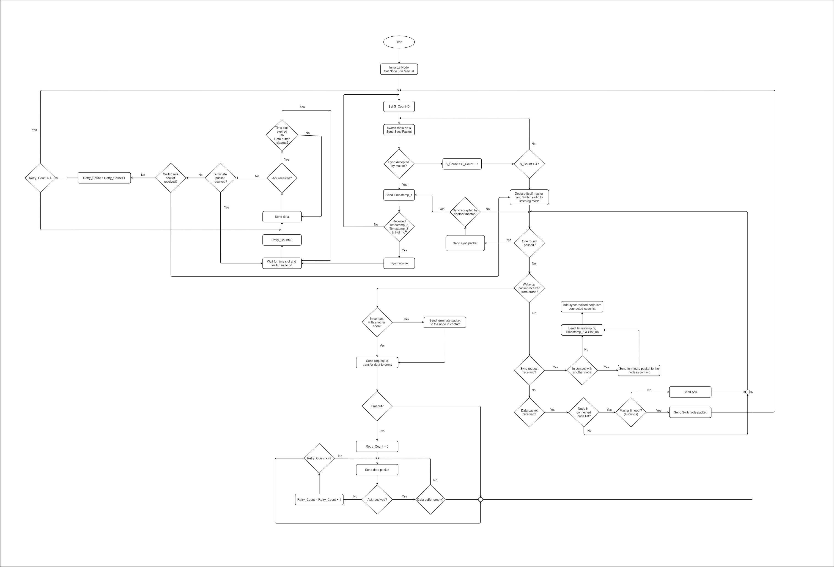
Lifecycle of the node
08/05/2020

Slide 25
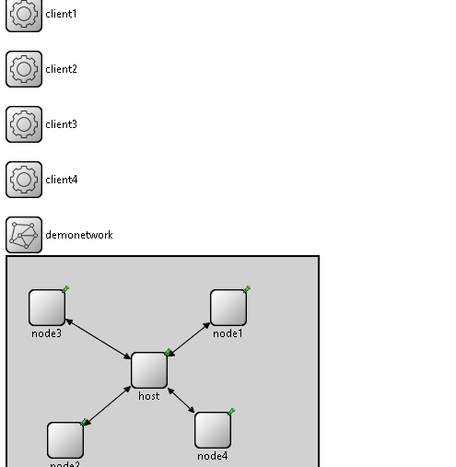
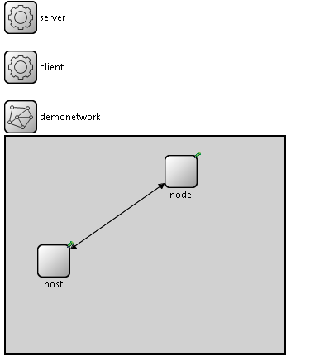
Simulations
08/05/2020

Slide 26
Next week goals
Complete the simulation taking into account,
Jitter
Propagation delay
Signal strength and distance
Time to switch on radio
Build a submodule to calculate power consumption
08/05/2020

Slide 27
Week 10
Objectives:
Design Mesh network………………………………………………………………………Complete
Design Communication protocol between node and drone…………..Complete
Simulate Mesh network…………………………………………………………………..On Progress
Simulate Communication protocol………………………………………………….On Progress
Combine Simulations……………………………………………………………………….Incomplete
Include power consumption calculation with the simulation…………Incomplete
Prepare an RFC…………………………………………………………………………………Incomplete
15/05/2020

Slide 28
This week’s progress
Explored INET framework
Analyzed 3 simulations
Client Server based TCP communication between n nodes
Ethernet bus communication communication between n nodes
WLAN communication 2.4GHz and 5GHz.
Proposed a design structure for the sensor node and the drone
15/05/2020

Slide 29
Why INET?
Message passing communication between modules
Layered communication(OSI model)
Radio Medium can be modelled
Has inbuilt components for integration
15/05/2020

Slide 30
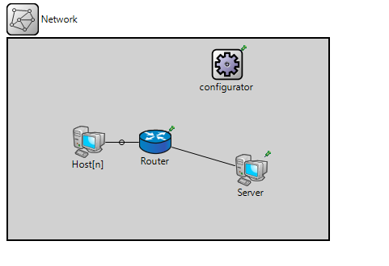
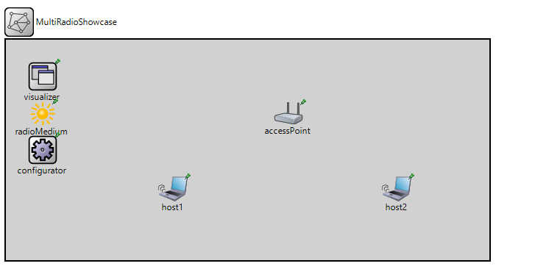
Simulations
15/05/2020

Slide 31
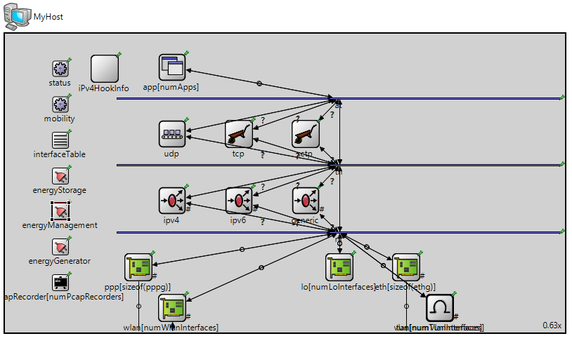
Design structure of a Wired Computer
15/05/2020

Slide 32
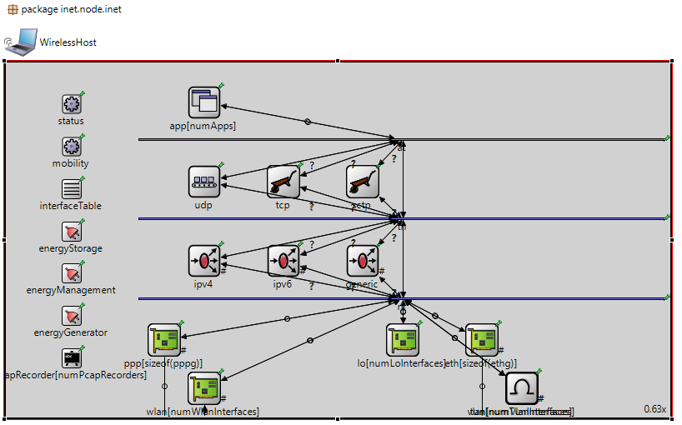
Design structure of a Wireless Computer
15/05/2020

Slide 33
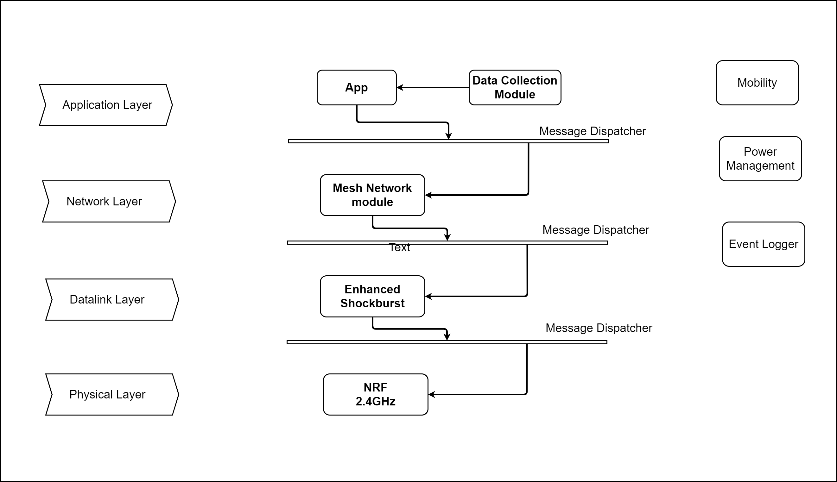
Proposed Structure of the Node
15/05/2020

Slide 34
Next Week Goals
Build Two Nodes with the proposed Structure (Without Enhanced Shockburst)
Pass Structured Messages
15/05/2020

Slide 35
Week 11
Objectives:
Design Mesh network………………………………………………………………………Complete
Design Communication protocol between node and drone…………..Complete
Simulate Mesh network…………………………………………………………………..On Progress
Simulate Communication protocol………………………………………………….On Progress
Combine Simulations……………………………………………………………………….Incomplete
Include power consumption calculation with the simulation…………Incomplete
Prepare an RFC…………………………………………………………………………………Incomplete
22/05/2020

Slide 36
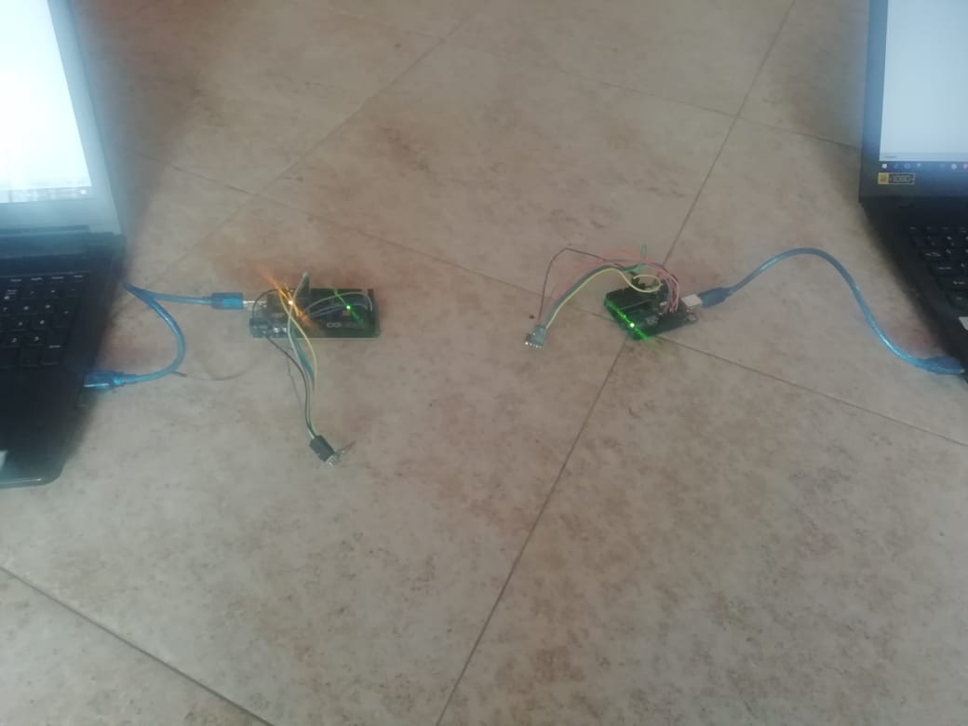
This week’s progress
Analyzed a wireless node, trying to reverse engineer the node and add the components in it.
Started implementing the mesh network in NRF24L01 modules.
Analyzed enhanced shockburst protocol
RFMesh network
22/05/2020

Slide 37
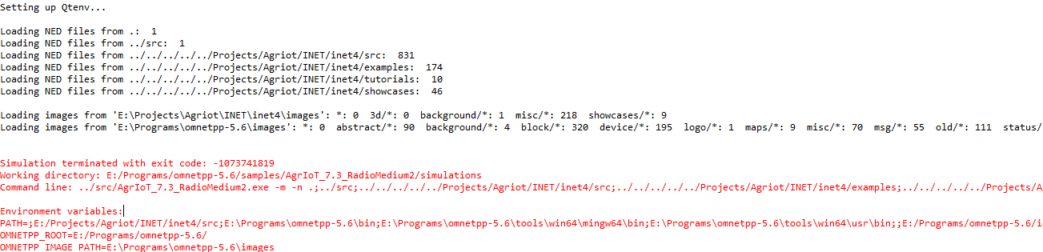
Wireless node modification
Segmentation fault
22/05/2020

Slide 38
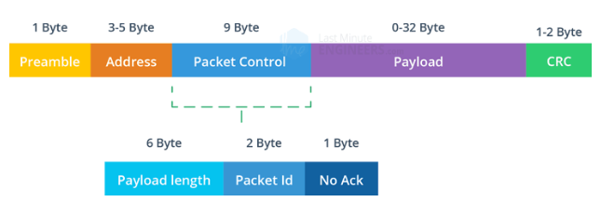
Enhanced Shockburst Overview
Supports a star network topology with typically one Primary Receiver and up to 8 Primary Transmitters
1 to 32 bytes dynamic payload length in legacy mode
1 to 252 bytes static payload length between nRF5 Series devices
Bidirectional data transfer between receiver and tranceiver
Packet acknowledgment and automatic packet retransmission
22/05/2020

Slide 39
Wireless Node vs AgrIoT Sensor Node
Wireless Node | AgrIoT Sensor Node
BPSK modulation | GFSK modulation
Dynamic software addressing | Static software addressing
IEEE802.11 | Enhanced Shockburst
IP based networking | Custom Mesh network protocol
22/05/2020

Slide 40
Next Week Goals
Build a Node with the proposed structure
22/05/2020

Slide 41
This week progress
Modelled the radio medium.
Modelled the radio
Included a mobile node with a defined path………….. Using Integrated Visualizer
Completed a 3D simulation the integration of the drone node……….. Using OSG Visualizer
Completed the power module
29/05/2020

Slide 42
Radio Medium Modelling
Modelled the radio medium by considering
Cache frequency: 2.4 GHz
Collision
Interference: Two Ray Ground Reflection
BitErrorRate: 1% Error Rate
Attenuation
Modulation: GFSK modulation should be implemented but currently APSK is used
29/05/2020

Slide 43
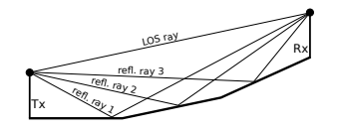
Two Ray Ground Reflection
Since the implementation will take place in an open environment, the possible interference are,
Cross interference from other 2.4 GHz communication
Two ray ground reflection
Two ray ground reflection. Source:[1]
A. Brummer, L. Ammon and A. Djanatliev, "N-Ray Ground Interference: Extending the Two-Ray Interference Model for 3D Terrain Shapes," 2019 IEEE Vehicular Networking Conference (VNC), Los Angeles, CA, USA, 2019, pp. 1-4, doi: 10.1109/VNC48660.2019.9062829.
29/05/2020

Slide 44
Radio Modelling
Modelled the radio by considering
frequency: 2.4 GHz
Bandwidth: 1 MHz
Datarate: 2Mbps
Available data rates are 250kbps,1Mbps and 2Mbps.
Lower air data rates receiver sensitivity is increased than lower data rate
Higher air data rate lower current consumption and reduced probability of on air collisions
Transmitter power.: -18dBm
Transmitter preamble Duration: 10µs(default value)
Transmitter header length: 17Byte (Maximum length)
Receiver Sensitivity: -85dBm
Receiver energy detection: Set to receiver sensitivity
Receiver snir Threshold: Set to default value
Buffering: 5 Packets
29/05/2020

Slide 45
Implementation of power module
Ideal Energy Storage was used so that battery depletion is not shown but the energy consumption will be calculated and shown as a statistic.
State based Energy Consumer is used
Off power consumption
Switching power consumption
Receiver Idle power consumption
Receiver busy power consumption
Transmitter Idle Power consumption
Transmitter transmitting power consumption
29/05/2020

Slide 46
Power statistics of NRF24L01
Available RF output powera at TX are 0dBm=11.3mA;-6dBm=9.0mA;-12dBm=7.5mA;-18dBm=7.0mA
Available RF output power at RX are 2Mbps=13.5mA;1Mbps=13.1mA;250kbps=12.6mA
Average current during TX settling=8.0mA(130us)
Average current during RX settling=8.9mA(130us)
900nA in power down
26uA in standby 1(external clock is dependent on signal swing)
320uA in standby 2(external clock is not dependent on signal swing)
400uA in startup(1.5ms)
Ideal power on time is 1ms......(Can go up to 100ms) Reset is also similar
Conditions: VDD=3V VSS=0V and Temp=-40to85C
29/05/2020

Slide 47
Calculations
Timing should be considered when implementing the power module: Currently it is not integrated.
To calculate the timing of radio state transitions, the state transition diagram can be used
To calculate the timing of the ESB cycle, the following set of equations can be used.(In the following slide)
P=VI is used to calculate the power
29/05/2020

Slide 48
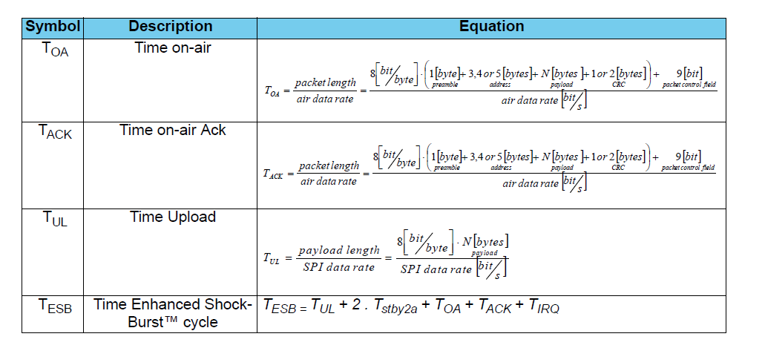
ESB full cycle time
29/05/2020

Slide 49
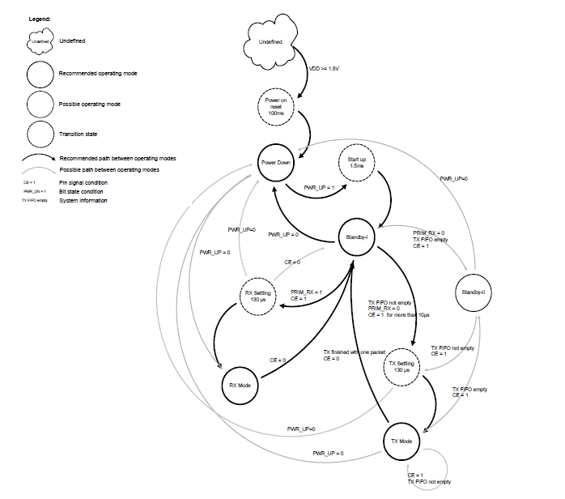
Radio states of NRF24L01
29/05/2020

Slide 50
Mobility of the node
Defined in components
Linear mobility
Circular mobility
Random mobility were implemented
Issues faced were:
When 3D visualizer was integrated with a 2D visualizer simulation was not generated.
29/05/2020

Slide 51
Next week goals
Fine tune the modules.
Complete and implement the application layer applications
29/05/2020

Slide 52
References
[1] A. Brummer, L. Ammon and A. Djanatliev, "N-Ray Ground Interference: Extending the Two-Ray Interference Model for 3D Terrain Shapes," 2019 IEEE Vehicular Networking Conference (VNC), Los Angeles, CA, USA, 2019, pp. 1-4, doi: 10.1109/VNC48660.2019.9062829.
29/05/2020

Slide 53
Thank you!

